Slide 1
Data imputation
Ada Gąssowska
Mateusz Grzyb
Elżbieta Jowik

Slide 2
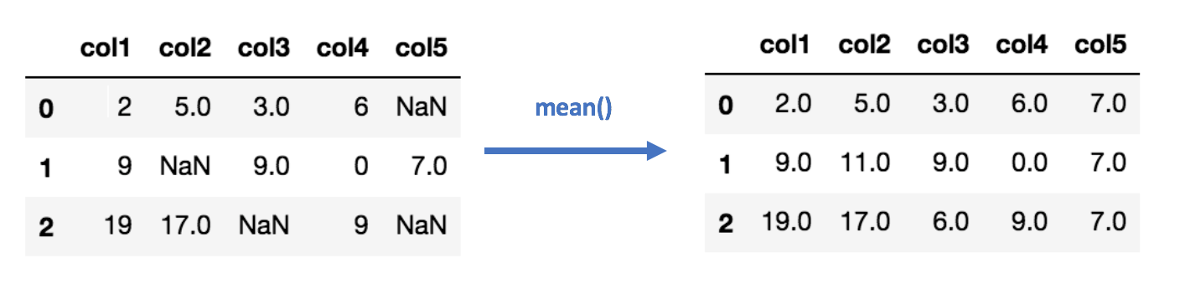
What is data imputation?

Slide 3
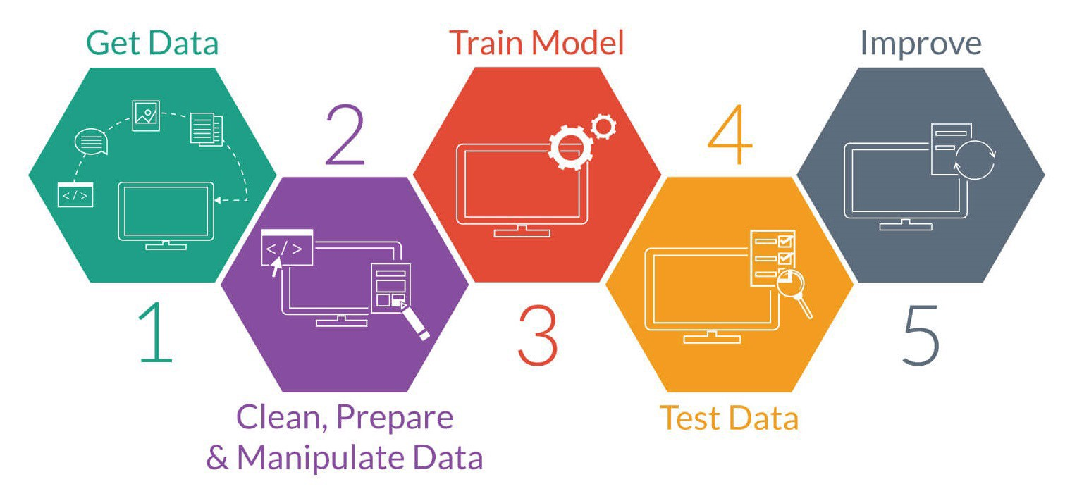
Why impute data?

Slide 4
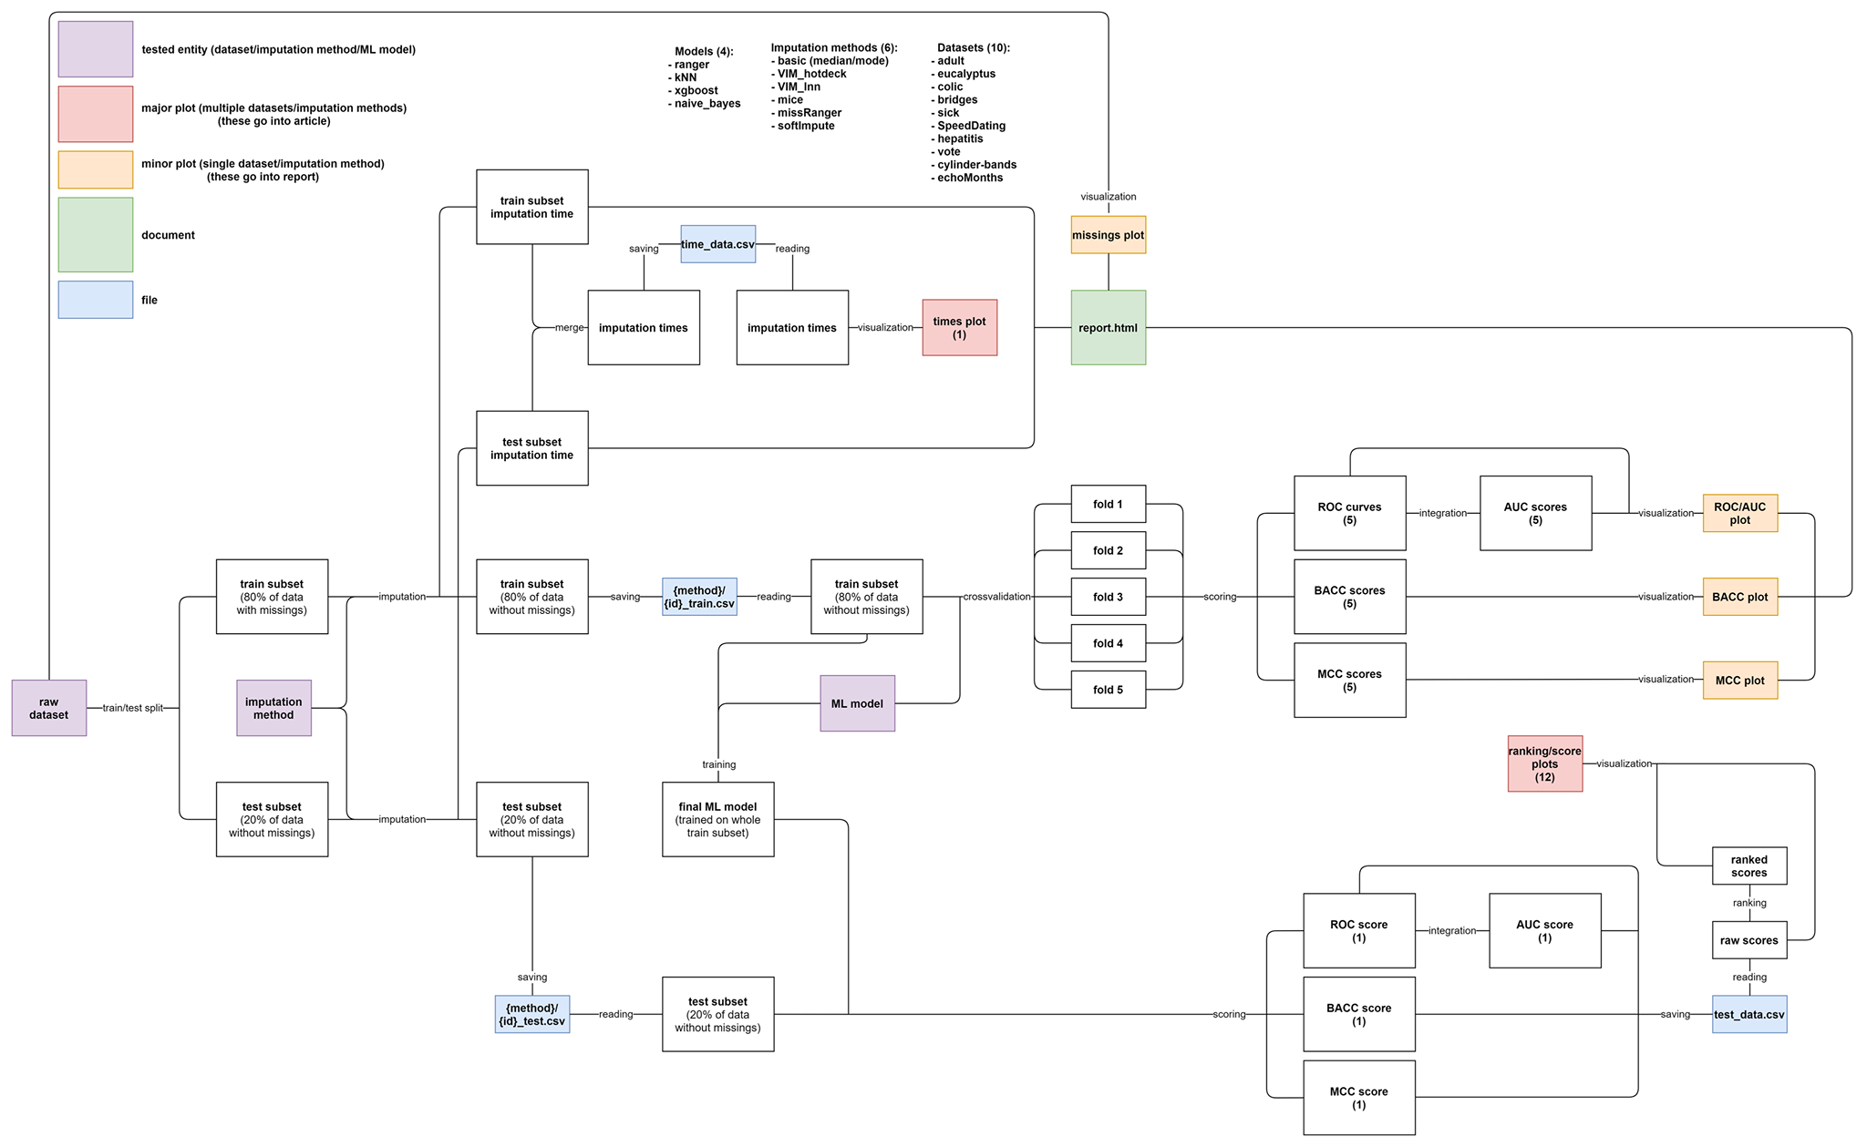
What did we test? How?

Slide 5
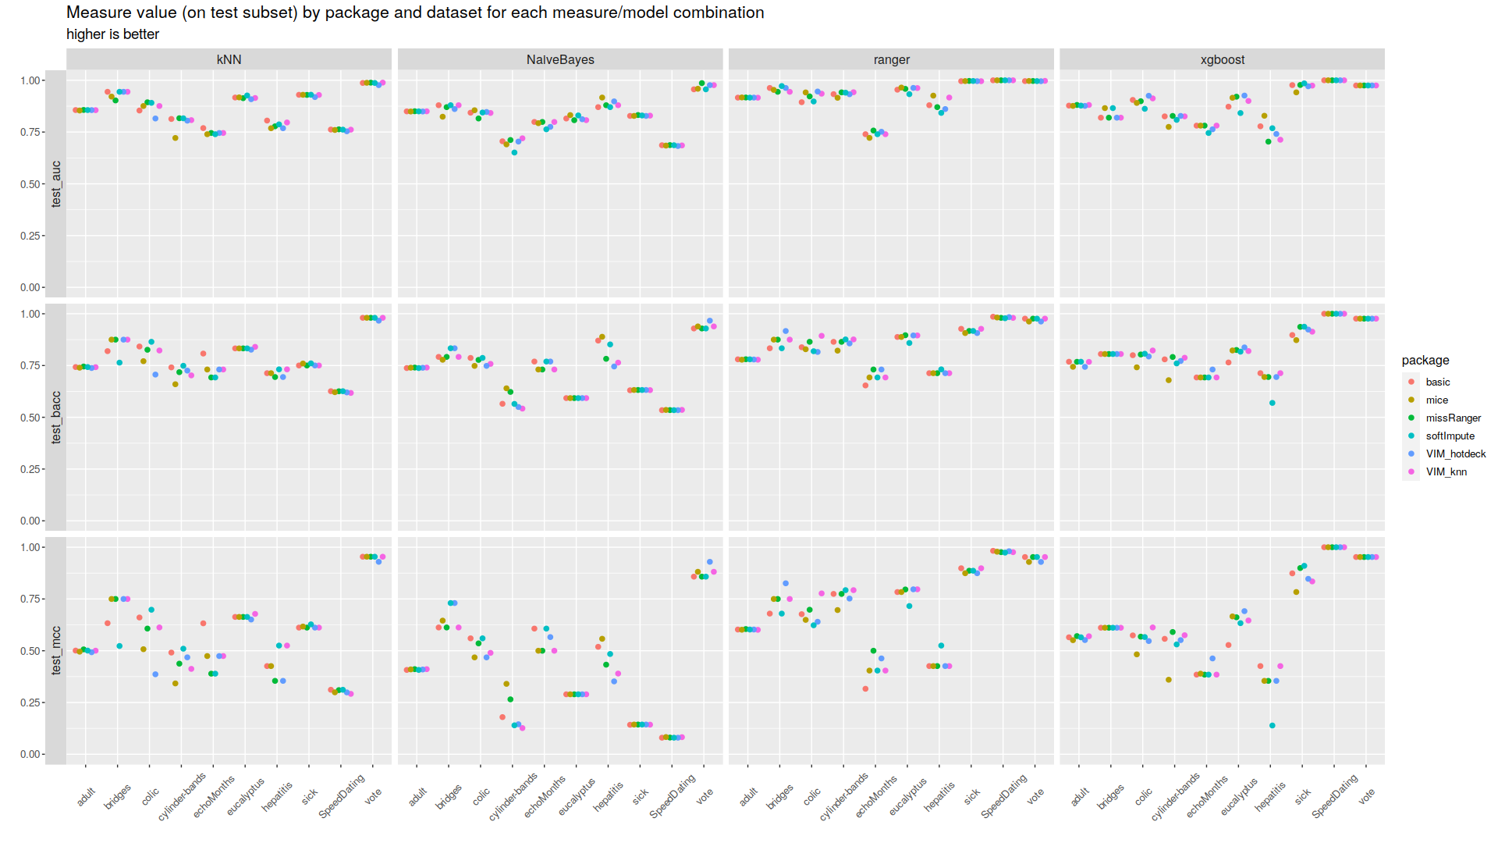
What are the results?

Slide 6
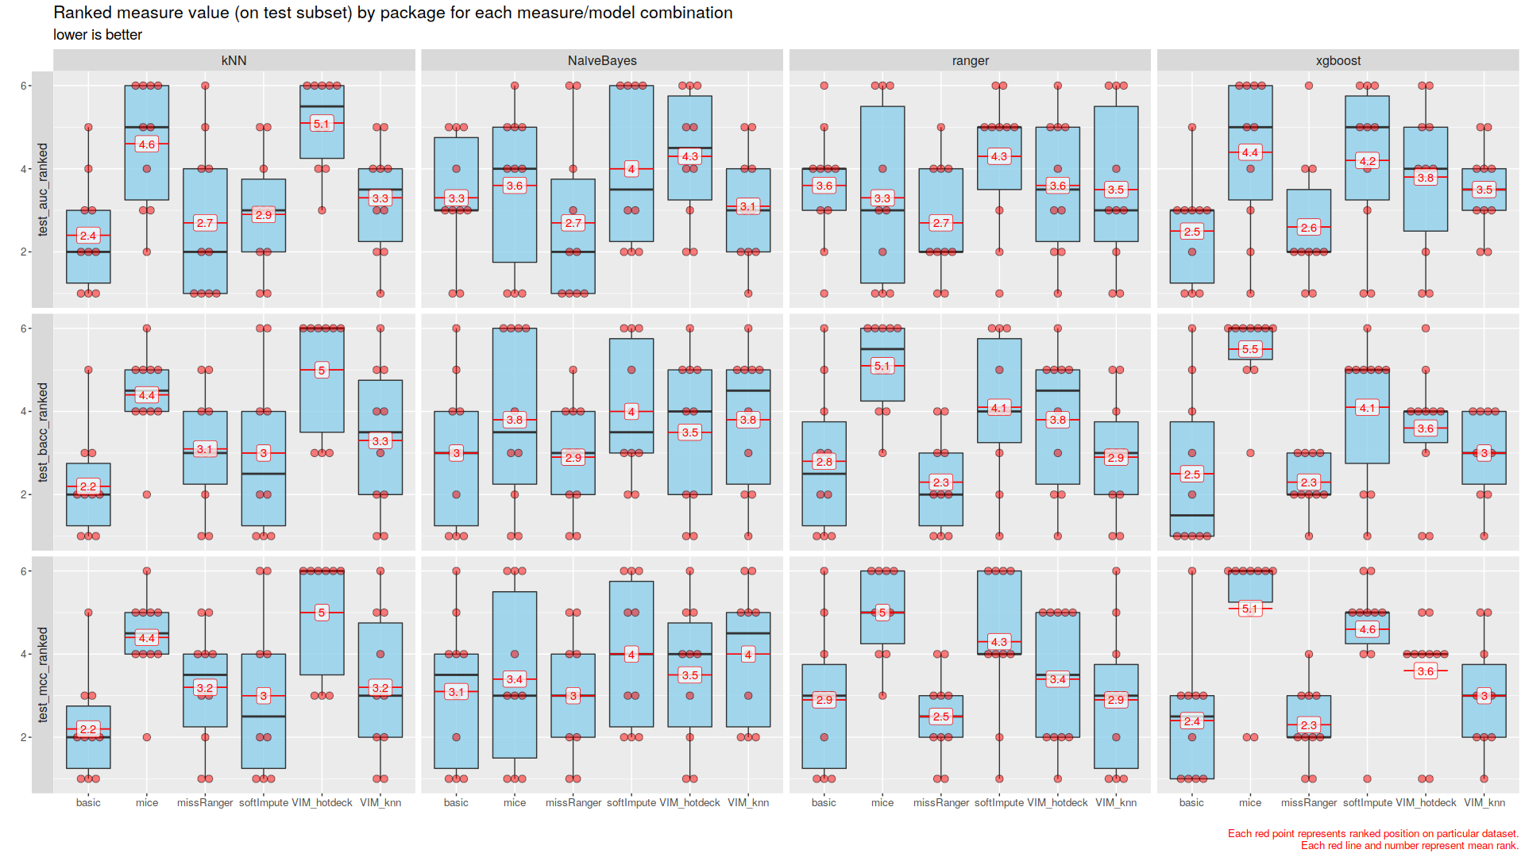
What are the results?

Slide 7
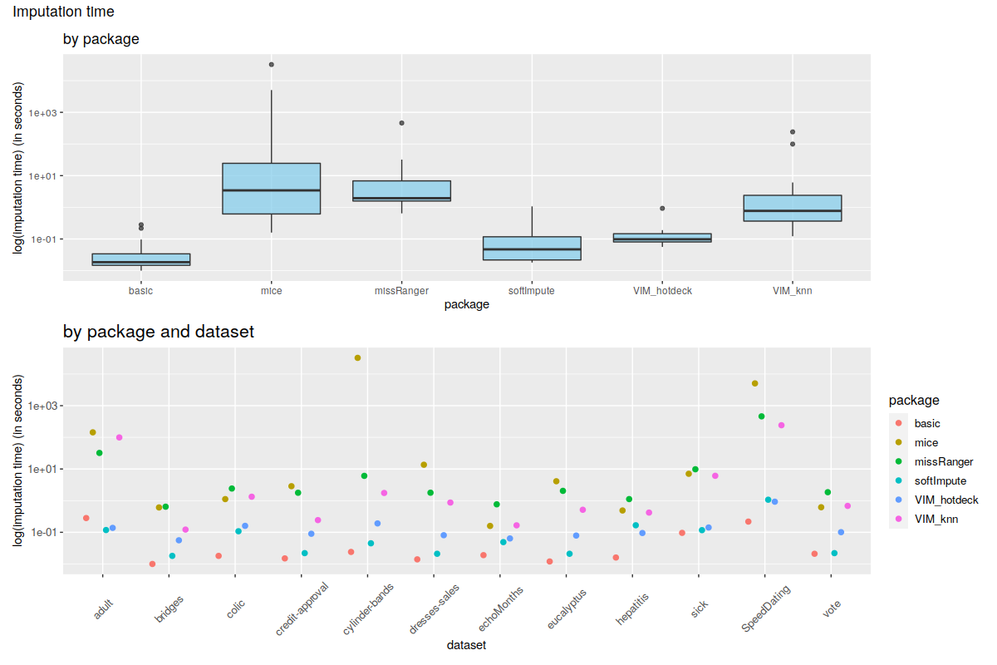
What are the results?

Slide 8
Questions?

Slide 9
Thank you!

